Slide 1
Media Comparisons
2023

Slide 2

Purpose of Media Comparisons Study
To gain an understanding of media usage, reach and time spent across traditional and digital platforms, and within market segments
The TVB commissioned GfK to do the study

Slide 3
Methodology

Slide 4
Research Methodology Overview
WHO:
Interviews were collected via opt-in panel.
The base sample included over 4,000 Adults 18+:
  3,700+ English-speaking panelists 18+ years of age and
  An augment of 300 Spanish speaking Hispanics 18+ years of age.
How:
Via a 21 minute online quantitative survey.
Care was taken to have an equal number of respondents reporting on each individual day so as not to overweight any individual day.
WHEN: Interviews took place November 3rd through December 1st, 2022.
Source: GfK TVB Media Comparisons Study 2023.

Slide 5
Two parts to the survey
  Time spent with media and reach
  Attitudinal and media preference questions
There were also questions about usage of key categories (Automotive, Home Remodelers, Legal, QSR, Shoppers, Urgent Care, Dentist/Eye Care, Voters, Online Sports Betting, Personal Insurance).
This allowed for delineation of media usage and attitudes, by product categories
Source: GfK TVB Media Comparisons Study 2023.

Slide 6


Part 1:
Reach and Time Spent

Slide 7
Reach and Time Spent Focus on the Individual and Their One Day Use of Media Platforms
Thinking about your use of “Media A” yesterday in any location, for about how long did you use “Media A” during each of these time periods?
 | Hours | Minutes
4am-9am
9am-4pm
4pm-8pm
8pm-2am

Slide 8
If users spent even one minute a day with a platform they were included in that platform’s “Reach”
“Time Spent,” reflects how much time people invest with a platform daily

Slide 9
Respondents Were Asked Questions on their Media Use by Device/Outlet
Traditional
  Television
  AM/FM and/or Satellite radio
  Printed Newspaper
  Printed Magazine
Digital
  Computer
  Smartphone
  Tablet or e-reader

Slide 10





These are the media platforms measured.
Respondents did not have to watch TV to be included in the study.
TV
Radio
Print
Digital
(Broadcast, Cable and Streaming)
(Newspaper and Magazine)
Digital media include:
Cable News site/app
Email
Local Radio Stations site/app
Broadcast TV News site/app
Digital Newspaper
Digital Magazine
Search
Streaming Audio
Social Media
Podcasts
Streaming Programs On Digital Media With Ads
Streaming Programs On Digital Media No Ads
Streaming Video Other Than TV Programs on Digital Media

Slide 11
Media Key Guide for Reach & Time-Spent
Traditional Devices/Platforms:
Broadcast TV = ABC, CBS, NBC, FOX, CW, Univision, Telemundo etc. live or time shifted (DVR or Video on Demand)
Cable TV = Fox News Channel, TNT, ESPN, USA, etc. live or time shifted (DVR or Video on Demand)
Total TV = Broadcast television and/or Cable television
Streaming Programs on TV With Ads = Using a streaming service on a TV set to stream programs/movies with advertising
Streaming Programs on TV No Ads = Using a streaming service on a TV set to stream programs/movies without any advertising
Streaming Video Other Than TV Programs on TV= Watch streaming video other than TV programs or movies, like YouTube or online-only videos on a TV
Radio = AM/FM and/or satellite radio
Newspaper = Printed newspaper
Magazine = Printed magazine
Digital Devices (on a computer, tablet or smartphone):
Email = Read/write/check email
Social Media = Read/post to social media (Facebook, Twitter, Instagram, TikTok, etc.)
Search = Use online search (Google, etc.)
Streaming Programs on Digital Media with Ads = Using a streaming service on a PC or mobile device to stream programs/movies with advertising
Streaming Programs on Digital Media No Ads = Using a streaming service on a PC or mobile device to stream programs/movies without any advertising
Streaming Video Other Than TV Programs on Digital Media = Watch streaming video other than TV programs or movies, like YouTube or online-only videos on a PC or mobile device
Local Radio Station’s websites/apps = Use a local radio station website/app via computer, tablet or smartphone
Streaming Audio = Use streaming audio (Pandora, Spotify, etc.) via computer, tablet or smartphone
Podcasts = Listen to podcasts via computer, tablet or smartphone
Internet-Print (Newspapers/Magazines) = Read a digital version of a newspaper or magazine (website or app)
Broadcast TV News Websites/Apps = Use a National broadcast or local TV station’s website or app for news, weather, or sports
Cable News Channels’ Websites/Apps = Use a cable
news channel’s website for news, weather or sports

Slide 12

Smartphone Usage Heavy for Social Media and Short Form Videos.
6 out of 10 Use PC for Email. Streaming Program Viewers Have Comparable Access for Smartphone and Computers
% of Time Spent
Social Media
Email
Streaming Programs with Ads- Digital
Streaming Video other than Programs- Digital
Source: GfK TVB Media Comparisons Study 2023. M-S 4A-2A. Persons 18+.

Slide 13
Digital platform usage was asked separately for each device. Results for Reach and Time Spent reflect the total of all three digital devices.
Source: GfK TVB Media Comparisons Study 2023. M-S 4A-2A. Persons 18+.

Slide 14
TV Has Highest Reach of Platforms
Broadcast Leads the Way
Source: GfK TVB Media Comparisons Study 2023. M-S 4A-2A. Persons 18+. Online/internet platforms such as email, social media, internet radio and websites, are totaled
for any online device-PC, Smartphone and Tablets. Broadcast TV News Websites/Apps includes local TV station & network websites/apps for news/weather/sports.

Slide 15
Broadcast Programs Dominate Rankers. The Streaming Programs that Made the Cut Did NOT Carry Any Advertising
Live+1 A25-54 Ranker: Nov. 13th, 2022
Live+1 A25-54 Ranker: Nov. 24th, 2022
Top 10
Top 50
Top 10
Top 50
Source: Nielsen NPOWER 11/13/22 and 11/24/22 Persons 25-54 Live+1. Broadcast (includes Syndication), Cable, and Streaming: Netflix, Amazon, Apple TV+, Disney+, HBO Max, Hulu.

Slide 16
Broadcast Builds Reach More Quickly with Fewer Programs Than Streaming Services’ Programming
Netflix Nov. 13th, 2022: L+1 A25-54
Reach
Netflix Nov. 24th, 2022: L+1 A25-54
Reach
18.11 AA Reach %
(22,021) AA Reach Proj. (000)
# of units needed
16.32 AA Reach %
(19,842) AA Reach Proj. (000)
# of units needed
Source: Nielsen NPOWER 11/13/22 and 11/24/22 Persons 25-54 Live+1 Reach. 5 Broadcast Networks (includes Syndication) and Netflix.

Slide 17
Broadcast TV is TV’s Primary Reach Engine
Source: GfK TVB Media Comparisons Study 2023. M-S 4A-2A. Persons 18+.

Slide 18
Why is it Important That Cable Only Adds 1 Reach Point to Broadcast?
Advertisers can see a reach number for broadcast of 76%, and a reach number for cable of 54% and think “if I add them together I can really reach my prospects – possibly 90%.”
That’s incorrect – they don’t realize the high amount of duplication cable has with broadcast and that it barely adds one percent to the reach
In fact advertisers can add more reach to their broadcast schedules by adding broadcast apps/websites.

Slide 19
Broadcast Websites Added More Reach to Broadcast TV than Cable or Streaming
_{0.6%}
_{Reach}
_{Added}
_{5.9%}
_{Reach}
_{Added}
_{2.5%}
_{Reach}
_{Added}
_{3.2%}
_{Reach}
_{Added}
Source: GfK TVB Media Comparisons Study 2023. M-S 4A-2A. Persons 18+.

Slide 20
Streaming with NO Advertising:
Advertisers Cannot Reach these Viewers
But Broadcast Assets Can Reach Most of Them
Source: GfK TVB Media Comparisons Study 2023. M-S 4A-2A. Persons 18+.

Slide 21
People Spend the Most Time with Television
Source: GfK TVB Media Comparisons Study 2023. M-S 4A-2A. Persons 18+. Online/internet platforms such as email, social media, internet radio and websites, are totaled for any online device-PC, Smartphone and Tablets. Broadcast TV News Websites/Apps includes local TV station & network websites/apps for news/weather/sports.

Slide 22
Most Time Spent with TV Programs is On Linear TV
Source: GfK TVB Media Comparisons Study 2023. M-S 4A-2A. Persons 18+.

Slide 23
Numbers Quoted for Streaming by Industry Include Streaming Without Ads.
When looking only at platforms that have advertising,
Linear TV Represents 80% of the Viewing Time
Time Spent On TV Screen Linear +
All Streaming (with & without ads)
Time Spent on TV Screen
With Ads Only
Source: GfK TVB Media Comparisons Study 2023. M-S 4A-2A. Persons 18+. Time Spent on TV set viewing programming (not short form).

Slide 24
Most Online is Not Exclusively Video
7:19
1:56
Source: GfK TVB Media Comparisons Study 2023. M-S 4A-2A. Persons 18+.

Slide 25
Screen Size Matters

Slide 26
More than 4 Times As Many Respondents Viewed Programs With Ads on Linear TV on Their Larger Screen TV Set
Than on Their Smartphone
Source: GfK TVB Media Comparisons Study 2023. M-S 4A-2A. Persons 18+.

Slide 27
A Measure of Engagement is How Much Time People Are Willing to Invest With a Platform Daily
If the experience of viewing on the two screen sizes were comparable, the gap in time spent should be much narrower
Source: GfK TVB Media Comparisons Study 2023. M-S 4A-2A. Persons 18+.

Slide 28
Part 2:
Attitude and Media Preference Questions

Slide 29


Slide 30
The Primary Source For News:
Broadcast Television
Which one of the following sources, if any,
would you say is your primary source for news?
Source: GfK TVB Media Comparisons Study 2023. Persons 18+. Includes only those who chose a media.
QO5 - Which one of the following sources, if any, would you say is your primary source for news? Broadcast TV News & Broadcast TV News Websites/Apps include local TV station & broadcast network telecasts and websites/apps for news/weather/sports.

Slide 31
The Primary Source For Local Traffic, Weather & Sports:
Local Broadcast Television News
What source do you turn to first for information about local weather, traffic, or sports?
Source: GfK TVB Media Comparisons Study 2023. Persons 18+. Includes only those who chose a media. QO6 - What source do you turn to first for information about local weather, traffic, or sports? Streaming Radio & Podcasts were under 1% each.

Slide 32
Local Broadcast Television News: #1 For Trust
I trust the News that I see/hear on this media source:
Percent Agree
Source: GfK TVB Media Comparisons Study 2023. Persons 18+. Agree Strongly or Agree Somewhat.
QO9 - For each source, please indicate the extent to which you agree or disagree with the following statement: I trust the News that I see/hear on this media source.

Slide 33
Local Broadcast Television News:
Most Involved In Your Community
Which source of news do you feel is the most involved in your community?
Source: GfK TVB Media Comparisons Study 2023. Persons 18+. Includes only those who chose a media.
QO8 - And, which source of news do you feel is the most involved in your community?

Slide 34
Local Broadcast Television Station Websites:
Top Choice For Local Information On News And Events
Websites Most Likely To Turn To When You Need Information
About Local News Or Events
Source: GfK TVB Media Comparisons Study 2023. Persons 18+. Includes only those who answered.
QO13 - Which one of the following websites are you most likely to turn to when you need information about local news or events? As a percentage of those that use websites and apps.

Slide 35
Television: Motivator & Influencer

Slide 36
Television Ads Motivate To Learn More
Source: GfK TVB Media Comparisons Study 2023. Persons 18+.
QO2 - From which of the following sources’ advertising are you most motivated to learn more about advertised products or brands you might like to try or buy? Respondent could select more than one answer. Broadcast TV News Websites/Apps includes local TV station & network websites/apps for news/weather/sports.

Slide 37
Television is The Top Advertising Medium That
Influences Purchase Decisions
Advertising medium which you feel most influences you to make a purchase decision
% Adults 18+
Source: GfK TVB Media Comparisons Study 2023. Persons 18+. Includes only those who chose a media.
QO1 - Please select the one type of advertising medium which, you feel, most influences you to make a purchase decision? Broadcast TV News Websites/Apps includes local TV station & network websites/apps for news/weather/sports.

Slide 38
Television Ads Are Motivation To Do
Further Research Online
Has an advertisement on television motivated you to go to the Internet to find out more information about that product or service?
Source: GfK TVB Media Comparisons Study 2023. Persons 18+.
QO3 - Has an advertisement on television motivated you to go the Internet to find out more information about that product or service?

Slide 39
“When visiting a local television station’s website/apps, do you look at the video ads?”
Source: GfK TVB Media Comparisons Study 2023.
QO12 - And, when visiting a local television station’s website/apps, how often do you look at the video ads? Of those who go to a local station’s website or app. Includes only those who answered every time, most of the time, or sometimes.

Slide 40
“Have you read or watched local broadcast TV station content on a social media site?”
Source: GfK TVB Media Comparisons Study 2023. Includes only those who answered all of the time, often, or sometimes.
QO10 - Have you ever read or watched local broadcast TV station content on a social media site like Facebook, Twitter, Instagram, or TikTok?

Slide 41
If you could choose only five networks, which five would you choose?

Slide 42


Out of 5 choices, the top 4 were Broadcast Networks
If you could choose only five networks, which five would you choose?
Network “A”
Network “B”
Network “C”
Network “D”
Network “E”
BROADCAST NETWORK
CABLE NETWORK
Source: GfK TVB Media Comparisons Study 2023. QTV4 – “Now think about all the television networks you watch, either regularly or occasionally. If you could choose only five networks, which five would you choose?” Respondents were given 50 choices of Broadcast and Cable Networks with an option to write in a network.

Slide 43
Out of 5 choices, the top 4 were Broadcast Networks
If you could choose only five networks, which five would you choose?
Network
“A”
Network
“B”
Network
“C”
Network
“D”
Network
“E”
Network
“A”
Network
“B”
Network
“C”
Network
“D”
Network
“E”
BROADCAST NETWORK
CABLE NETWORK
Source: GfK TVB Media Comparisons Study 2023. QTV4 – “Now think about all the television networks you watch, either regularly or occasionally. If you could choose only five networks, which five would you choose?” Respondents were given 50 choices of Broadcast and Cable Networks with an option to write in a network.

Slide 44


“If you could choose only five networks, which five would you choose?”
Network
“A”
Network
“B”
Network
“C”
Network
“D”
Network
“E”
Network
“A”
Network
“B”
Network
“C”
Network
“D”
Network
“E”
SPANISH BROADCAST
ENGLISH BROADCAST
CABLE NETWORK
Source: GfK TVB Media Comparisons Study 2023. QTV4 – “Now think about all the television networks you watch, either regularly or occasionally. If you could choose only five networks, which five would you choose?” Respondents were given 50 choices of Broadcast and Cable Networks with an option to write in a network.

Slide 45
Out of 5 choices, 4 were Broadcast Networks
If you could choose only five networks, which five would you choose?
BROADCAST NETWORK
CABLE NETWORK
Network
“A”
Network
“B”
Network
“C”
Network
“D”
Network
“E”
Net
“A”
Net
“B”
Net
“C”
Net
“D”
Net
“E”
Net
“A”
Net
“B”
Net
“C”
Net
“D”
Net
“E”
Net
“A”
Net
“B”
Net
“C”
Net
“D”
Net
“E”
Source: GfK TVB Media Comparisons Study 2023. QTV4 – “Now think about all the television networks you watch, either regularly or occasionally. If you could choose only five networks, which five would you choose?” Respondents were given 50 choices of Broadcast and Cable Networks with an option to write in a network.

Slide 46
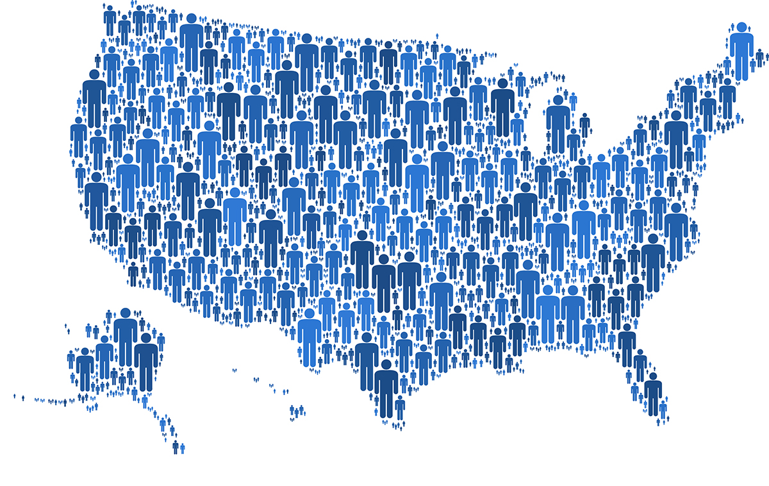
Demographics

Slide 47
TV Has The Highest Reach for All Ages
Source: GfK TVB Media Comparisons Study 2023. M-S 4A-2A. Online/internet platforms such as email, social media, internet radio and websites, are totaled for any online device-PC, Smartphone and Tablets. Broadcast TV News Websites/Apps includes local TV station & network websites/apps for news/weather/sports.

Slide 48
The Difference in Time Spent for TV Versus Other Media is Dramatic, for All Age Groups
Source: GfK TVB Media Comparisons Study 2023. M-S 4A-2A. Online/internet platforms such as email, social media, internet radio and websites, are totaled for any online device-PC, Smartphone and Tablets. Broadcast TV News Websites/Apps includes local TV station & network websites/apps for news/weather/sports.

Slide 49
Adults 35+ Reach: TV Highest, Followed by Email & Search
% Reached Yesterday
Source: GfK TVB Media Comparisons Study 2023. M-S 4A-2A. Adults 35+. Online/internet platforms such as email, social media, internet radio and websites, are totaled for any online device-PC, Smartphone and Tablets. Broadcast TV News Websites/Apps includes local TV station & network websites/apps for news/weather/sports.

Slide 50
Adults 35+
Time Spent: TV More Than 5X Higher Than Email
Daily Time Spent Yesterday
(In Hours:Minutes)
Source: GfK TVB Media Comparisons Study 2023. M-S 4A-2A. Adults 35+. Online/internet platforms such as email, social media, internet radio and websites, are totaled for any online device-PC, Smartphone and Tablets. Broadcast TV News Websites/Apps includes local TV station & network websites/apps for news/weather/sports.

Slide 51
Adults 25-54
Reach: TV Highest, Followed by Social Media & Search
% Reached Yesterday
Source: GfK TVB Media Comparisons Study 2023. M-S 4A-2A. Adults 25-54. Online/internet platforms such as email, social media, internet radio and websites, are totaled for any online device-PC, Smartphone and Tablets. Broadcast TV News Websites/Apps includes local TV station & network websites/apps for news/weather/sports.

Slide 52
Adults 25-54
Time Spent: TV 4X Higher Than Social Media
Daily Time Spent Yesterday
(In Hours:Minutes)
Source: GfK TVB Media Comparisons Study 2023. M-S 4A-2A. Adults 25-54. Online/internet platforms such as email, social media, internet radio and websites, are totaled for any online device-PC, Smartphone and Tablets. Broadcast TV News Websites/Apps includes local TV station & network websites/apps for news/weather/sports.

Slide 53
Adults 18-34
Reach: TV Highest, Followed by Social Media & Streaming Video
% Reached Yesterday
Source: GfK TVB Media Comparisons Study 2023. M-S 4A-2A. Adults 18-34. Online/internet platforms such as email, social media, internet radio and websites, are totaled for any online device-PC, Smartphone and Tablets. Broadcast TV News Websites/Apps includes local TV station & network websites/apps for news/weather/sports.

Slide 54
Adults 18-34
Time Spent: TV Dramatically Higher Than Any Platform
Daily Time Spent Yesterday
(In Hours:Minutes)
Source: GfK TVB Media Comparisons Study 2023. M-S 4A-2A. Adults 18-34. Online/internet platforms such as email, social media, internet radio and websites, are totaled for any online device-PC, Smartphone and Tablets. Broadcast TV News Websites/Apps includes local TV station & network websites/apps for news/weather/sports.

Slide 55


Black/African Americans & Hispanics

Slide 56
TV Has Highest Reach of
Ad Supported Platforms For Black/African Americans
Black/African Americans
% Reached Yesterday
Source: GfK TVB Media Comparisons Study 2023. M-S 4A-2A. Online/internet platforms such as email, social media, internet radio and websites, are totaled for any online device-PC, Smartphone and Tablets. Broadcast TV News Websites/Apps includes local TV station & network websites/apps for news/weather/sports.

Slide 57
Black/African Americans Spend the Most Time with Television of All Ad Supported Platforms
Black/African Americans
Daily Time Spent Yesterday
(In Hours:Minutes)
Source: GfK TVB Media Comparisons Study 2023. M-S 4A-2A. Online/internet platforms such as email, social media, internet radio and websites, are totaled for any online device-PC, Smartphone and Tablets. Broadcast TV News Websites/Apps includes local TV station & network websites/apps for news/weather/sports.

Slide 58
TV Has Highest Reach of
Ad Supported Platforms For Hispanics
Hispanics
% Reached Yesterday
Source: GfK TVB Media Comparisons Study 2023. M-S 4A-2A. Online/internet platforms such as email, social media, internet radio and websites, are totaled for any online device-PC, Smartphone and Tablets. Broadcast TV News Websites/Apps includes local TV station & network websites/apps for news/weather/sports.

Slide 59
Hispanics Spend the Most Time with Television of All Ad Supported Platforms
Hispanics
Daily Time Spent Yesterday
(In Hours:Minutes)
Source: GfK TVB Media Comparisons Study 2023. M-S 4A-2A. Online/internet platforms such as email, social media, internet radio and websites, are totaled for any online device-PC, Smartphone and Tablets. Broadcast TV News Websites/Apps includes local TV station & network websites/apps for news/weather/sports.

Slide 60

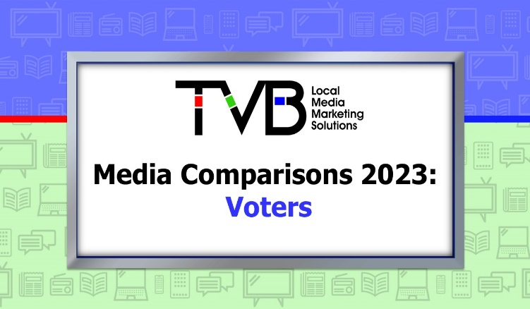


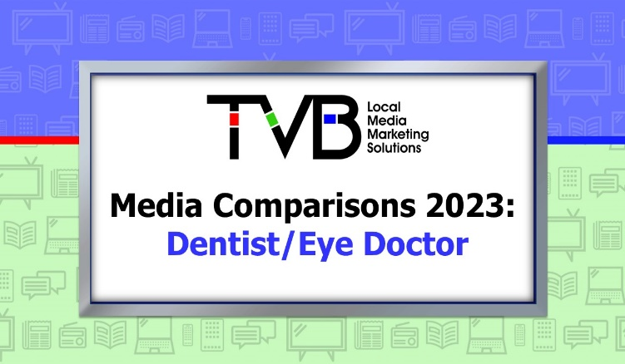



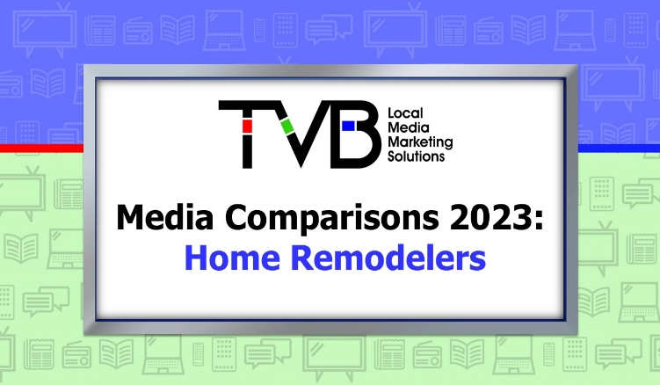
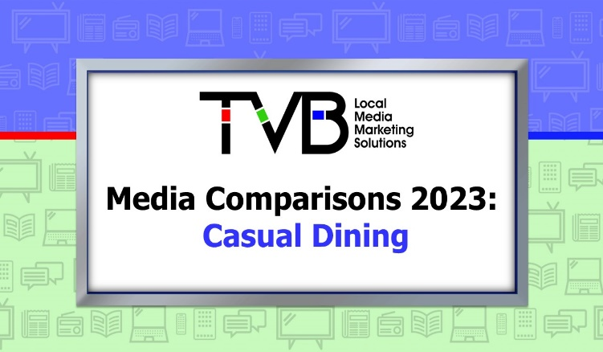

Categories

Slide 61
Broadcast TV is TV’s Primary
Reach Engine For Key Categories
Source: GfK TVB Media Comparisons Study 2023. M-S 4A-2A. Persons 18+.

Slide 62
Streaming with NO Advertising:
Advertisers Cannot Reach these Viewers
But Broadcast Assets Can Reach Most of Them
Source: GfK TVB Media Comparisons Study 2023. M-S 4A-2A. Persons 18+ Car Buyers.

Slide 63
Streaming with NO Advertising:
Advertisers Cannot Reach these Viewers
But Broadcast Assets Can Reach Most of Them
Source: GfK TVB Media Comparisons Study 2023. M-S 4A-2A. Persons 18+ Dentist/Eye Doctor visitors.

Slide 64
Home Remodelers Spend the
Most Time with Television
Source: GfK TVB Media Comparisons Study 2023. M-S 4A-2A. Persons 18+ Plan to remodel any portion of current home in next year: Yes. Online/internet platforms such as email, social media, internet radio and websites, are totaled for any online device-PC, Smartphone and Tablets. Broadcast TV News Websites/Apps includes local TV station & network websites/apps for news/weather/sports.

Slide 65
TV Ads Top Motivator to Learn More About Products
In-Store Shoppers
Online Shoppers
Personal Insurance
QSR/Casual Dining
Source: GfK TVB Media Comparisons Study 2023. Persons 18+.
QO2 - From which of the following sources’ advertising are you most motivated to learn more about advertised products or brands you might like to try or buy? Respondent could select more than one answer. Broadcast TV News Websites/Apps includes local TV station & network websites/apps for news/weather/sports.

Slide 66
Key Findings: Reach and Time Spent
TV has the highest reach and time spent of all media platforms studied.
Most TV viewers are reached through broadcast TV.
If streaming platforms have no advertising, advertisers cannot reach these viewers. But Broadcast assets can reach most of them.
Broadcast websites add more reach to Broadcast TV than cable or streaming.
More than four times as many respondents viewed programs with ads on linear TV on their larger screen TV set than on their smartphone.
Numbers quoted for streaming by the industry include streaming without ads. When looking only at platforms that have advertising, linear TV represents 80% of the viewing time.

Slide 67
Key Findings: Attitude and Media Preference
Local Broadcast TV is turned to most for local news.
Local TV news is the most trusted news source. Local TV News websites/apps are the most trusted digital source. Social Media is the least trusted platform.
TV is the top advertising medium for purchase influence and motivating respondents to learn more about products.
Television ads are motivation to do further research online.
Respondents watched ads on a local TV station website and read or watched local broadcast TV station content on a social media site.
When picking only five networks, the top four are on broadcast TV.

Slide 68
Key Findings: Demographics, Categories
Television is tops for reach for all age groups and categories.
All demographics spent at least 2.5 times more hours/minutes with TV than the next closest media platform – even adults 18-34.
For all demographics and categories measured, TV ads strongly motivate respondents to do further research online.

Slide 69
Thank You!

