Slide 1


SkillUp: Harnessing Our Emotions

Slide 2


Thank you to our Underwriter
And our Supporting Partners
ABC Owned Television Stations, AdCellerant, BIA Advisory Services, Comscore, Cox Media Group, The E.W. Scripps Company, Graham Media Group, Gray Television, Hearst Television, Katz Television Group, Locality, Marathon Ventures, Morgan Murphy Media,
NBCUniversal Local, Nielsen, Standard Media Group, Telemundo, Univision Television Group, Vivvix

Slide 3
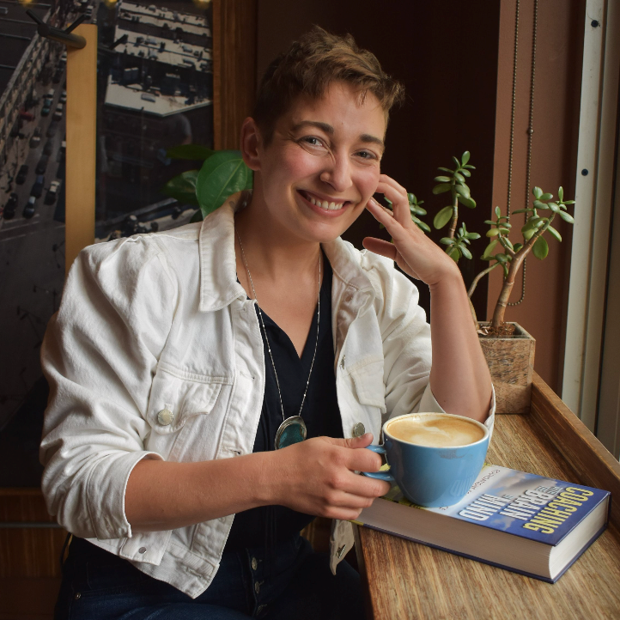
SkillUp: Harnessing Our Emotions
Emma Miele, MA, PCC
Founder & Coach
The Breathing Room

Slide 4

Harnessing our Emotions
SKILLUP:
with
Emma Miele
Coach and Founder
The Breathing Room LLC,
COACHING AND FACILITATING

Slide 5


'There’s
NO CRYING in baseball!
TODAY WE WILL…
Understand the core emotions and purpose of each
Gain insight into what emotional regulation is and how you can access it
Apply emotional regulation in common workplace scenarios

Slide 6



I have no difficulty holding both logic and feeling at the same time, and it does not diminish my powers,
it EXPANDS them.”
- Lawyer Barbie

Slide 7


Emo•tion•al
In•tel•li•gence (EQ)
noun
The ability to understand and manage your emotions, as well as recognize and influence the emotions of those around you

Slide 8

EMOTIONAL REGULATION AND FACILITY
What it is NOT

Slide 9

What it IS
EMOTIONAL REGULATION AND FACILITY

Slide 10










Core Emotions and Their Purpose
ANGER
To catapult us away from that which is endangering us
The catalytic emotion
JOY
Purpose of getting us more of what matters to us
HURT
To let us know a harm or injustice has occurred
SADNESS
Mourning a loss to make space for the future
FEAR
Purpose of moving us away from danger
Notes:
I want this one to be a build slide plzzz

Slide 11


The Four Directions of Emotional Facility
UP
IN
OUT
DOWN
Notes:
Add to this one- what is up and down and how can they be activated

Slide 12

Ability to notice what is happening inside yourself and others
The Four Directions of Emotional Facility
UP
IN
OUT
Ability to express your emotions in ways other people can understand
DOWN
Notes:
Add to this one- what is up and down and how can they be activated

Slide 13
The Four Directions of Emotional Facility
UP
Ability to increase your affect or intensity in expression
IN
OUT
DOWN
Ability to soothe, calm, or modulate intensity

Slide 14







Our Emotional Toolkit
FEAR
HURT
ANGER
SADNESS
JOY
PROCESS OF EMOTIONAL REGULATION
NOTICE
PAUSE
LABEL
ANALYZE
ACT!
Notes:
We can also take out the in, up, down, out words since those will be included in the future slides-EM

Slide 15



PHYSICAL SYMPTOMS OF HIJACK
NOTICE
Feeling frozen
Sweaty palms
Racing heartbeat
Flushed face
Heated core
Tears in eyes
Feeling a ‘gut punch’
Feeling a ‘gut clench’
Loss of word
Tunnel vision
Urge to run
Urge to lash out or fight
Nausea
Disassociation
PROCESS OF EMOTIONAL REGULATION
NOTICE
PAUSE
LABEL
ANALYZE
ACT!
Notes:
Add footer with all the steps, current step bolded- Notice, Pause, Label, Analyze, Act

Slide 16



PAUSE
PROCESS OF EMOTIONAL REGULATION
NOTICE
PAUSE
LABEL
ANALYZE
ACT!
Notes:
Add footer with all the steps, current step bolded- Notice, Pause, Label, Analyze, Act

Slide 17

LABEL
FEAR
Freezing, sweaty palms, urge to run, sensation of ‘falling’
Gut punch or gut clench, tears in eyes, sensation of being hit or struck down, sense of disappointment, tightness in throat or chest
HURT
Urge to lash out, warmth in face or body, clenching fists, clenched jaw, tightness in throat or chest
ANGER
SADNESS
Sense of loss, emptiness in gut, sense of hopelessness, feeling deflated
JOY
Urge to smile or leap, laughter, sense of being uplifted, feeling connected to others
PROCESS OF EMOTIONAL REGULATION
NOTICE
PAUSE
LABEL
ANALYZE
ACT!

Slide 18

ANALYZE
FEAR
Purpose of moving us away from danger
STEP ONE
Purpose of knowing a harm or injustice has occurred. Something is happening that we are uncomfortable with
HURT
Emotions and their purpose
To catapult us away from that which is endangering us. The catalytic emotion, always preceded by fear, hurt, or both
ANGER
SADNESS
Mourning a loss to make space for the future
JOY
Purpose of getting us more of what matters to us
PROCESS OF EMOTIONAL REGULATION
NOTICE
PAUSE
LABEL
ANALYZE
ACT!
Notes:
Analyze has three subsections haha it’s so funny to break this stuff down! Honestly analyze also has a section about discovering which emotions are relevant in the moment and which are past, how to distinguish between objective data and our inference of the data…too much for one slide or one webinar…that’s part two and three of Emma’s budding course

Slide 19

ANALYZE
STEP TWO
What do I need?
By understanding the purpose of the emotion, we can more clearly identify what we need in the situation
Safety, preparation, acknowledgement, space, boundary, understanding etc.
PROCESS OF EMOTIONAL REGULATION
NOTICE
PAUSE
LABEL
ANALYZE
ACT!
Notes:
Analyze has three subsections haha it’s so funny to break this stuff down! Honestly analyze also has a section about discovering which emotions are relevant in the moment and which are past, how to distinguish between objective data and our inference of the data…too much for one slide or one webinar…that’s part two and three of Emma’s budding course

Slide 20
ANALYZE
UP
STEP THREE
Which direction will be most helpful to get what I need?
DOWN
PROCESS OF EMOTIONAL REGULATION
NOTICE
PAUSE
LABEL
ANALYZE
ACT!
Notes:
Add more data here

Slide 21
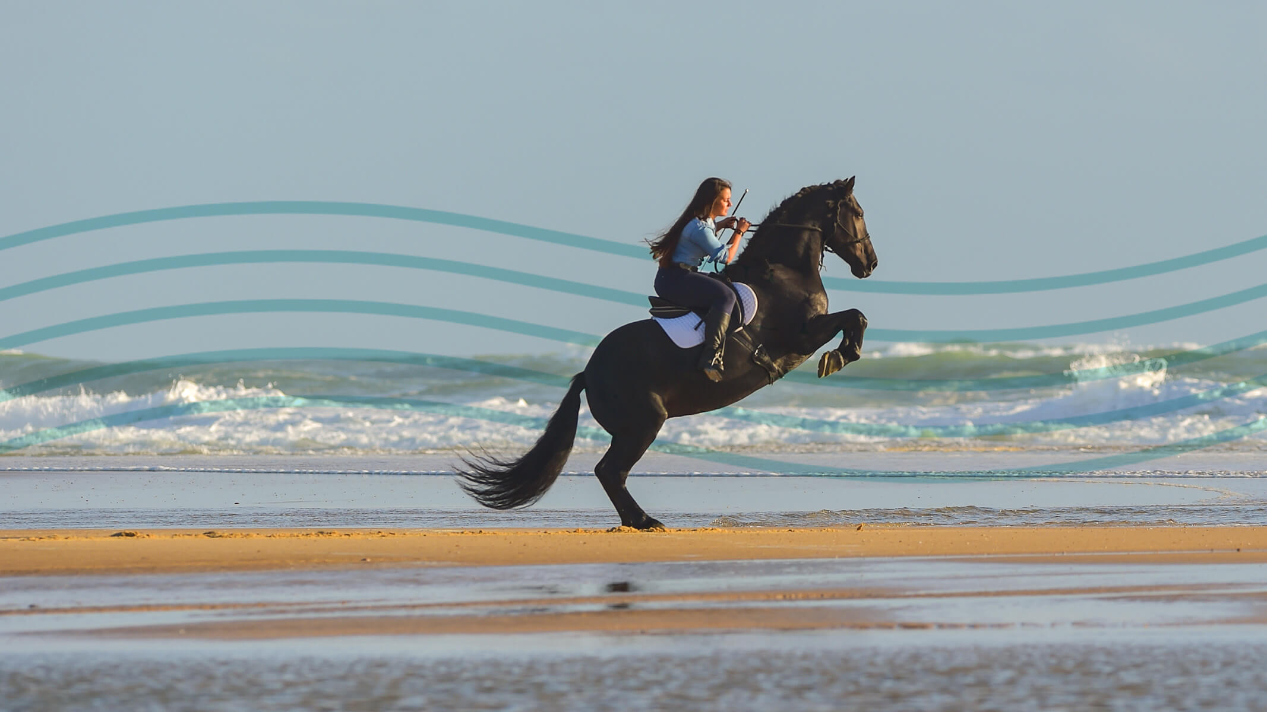



ACT!
OUT
With the data you collected, use your OUT regulation to express your experience and get what you need!
PROCESS OF EMOTIONAL REGULATION
NOTICE
PAUSE
LABEL
ANALYZE
ACT!

Slide 22






DECISION TREE
1.
I NOTICE my body feels
sweaty palms
racing
heart
flushed face or core
tears in
eyes
gut punch
loss of
words
tunnel vision
2.
PAUSE
… breathe …
3.
LABEL
I feel …
can be more than one
FEAR
HURT
ANGER
SADNESS
JOY
4.
ANALYZE
What is the purpose of this emotion?
Our Emotional Toolkit
What do I need?
Which direction will be most helpful?
UP
DOWN
Have I address all emotions?
5.
ACT!
YES
NO
3.
© The Breathing Room LLC, Coaching and Facilitating, April 2024
www.findyourbreathingroom.com

Slide 23

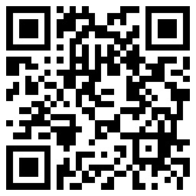
Let’s Hang Out!
773-629-2794
https://www.linkedin.com/in/emma-miele/
www.findyourbreathingroom.com

Slide 24
Thank you to our Underwriter
And our Supporting Partners
ABC Owned Television Stations, AdCellerant, BIA Advisory Services, Comscore, Cox Media Group, The E.W. Scripps Company, Graham Media Group, Gray Television, Hearst Television, Katz Television Group, Locality, Marathon Ventures, Morgan Murphy Media,
NBCUniversal Local, Nielsen, Standard Media Group, Telemundo, Univision Television Group, Vivvix
Thank you for joining us!

