Slide 1
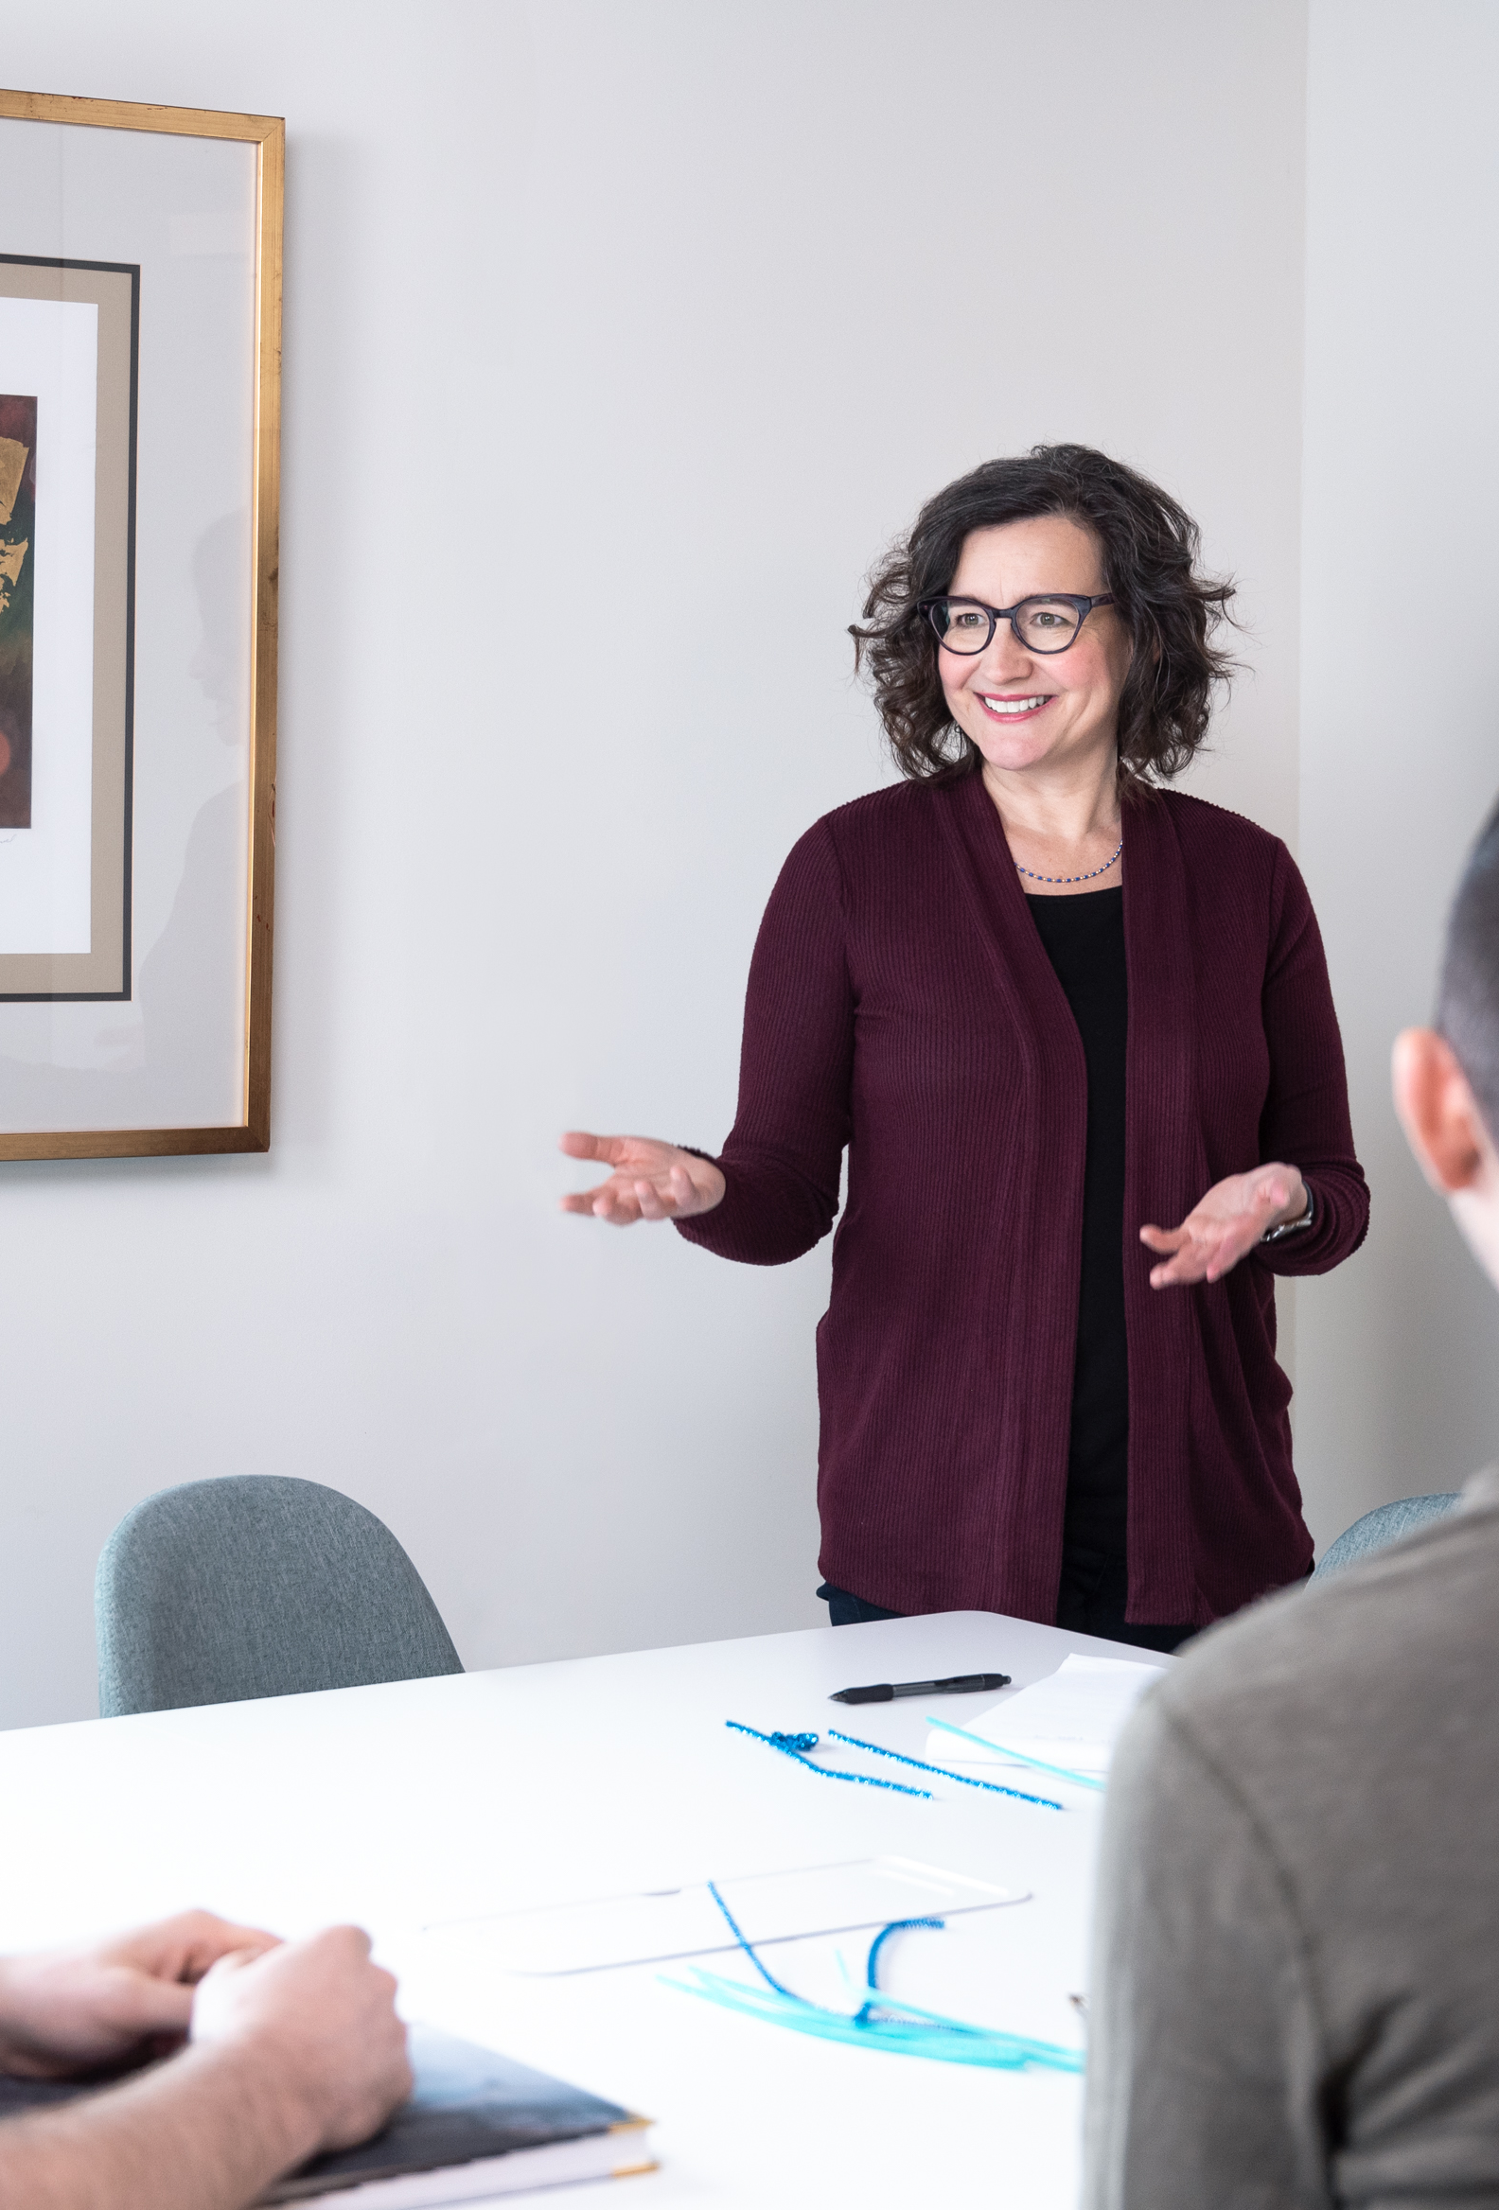
SPEAK WITH STRENGTH for
TVB Forward Virtual Sales Conference 2024
Marianna Swallow
Speaker + Coach

Slide 2

SPEAK WITH STRENGTH
Marianna Swallow
Speaker + Coach

Slide 3

SPEAK WITH STRENGTH
Marianna Swallow
Speaker + Coach

Slide 4
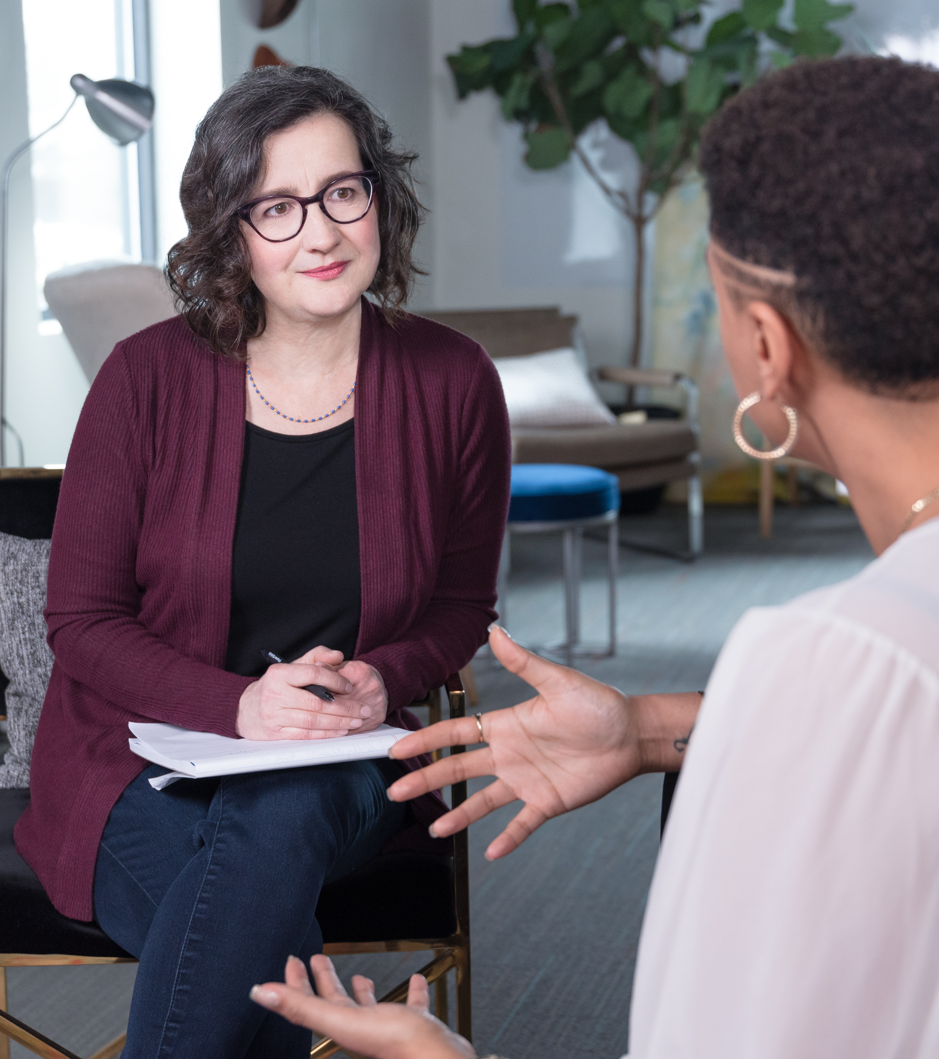
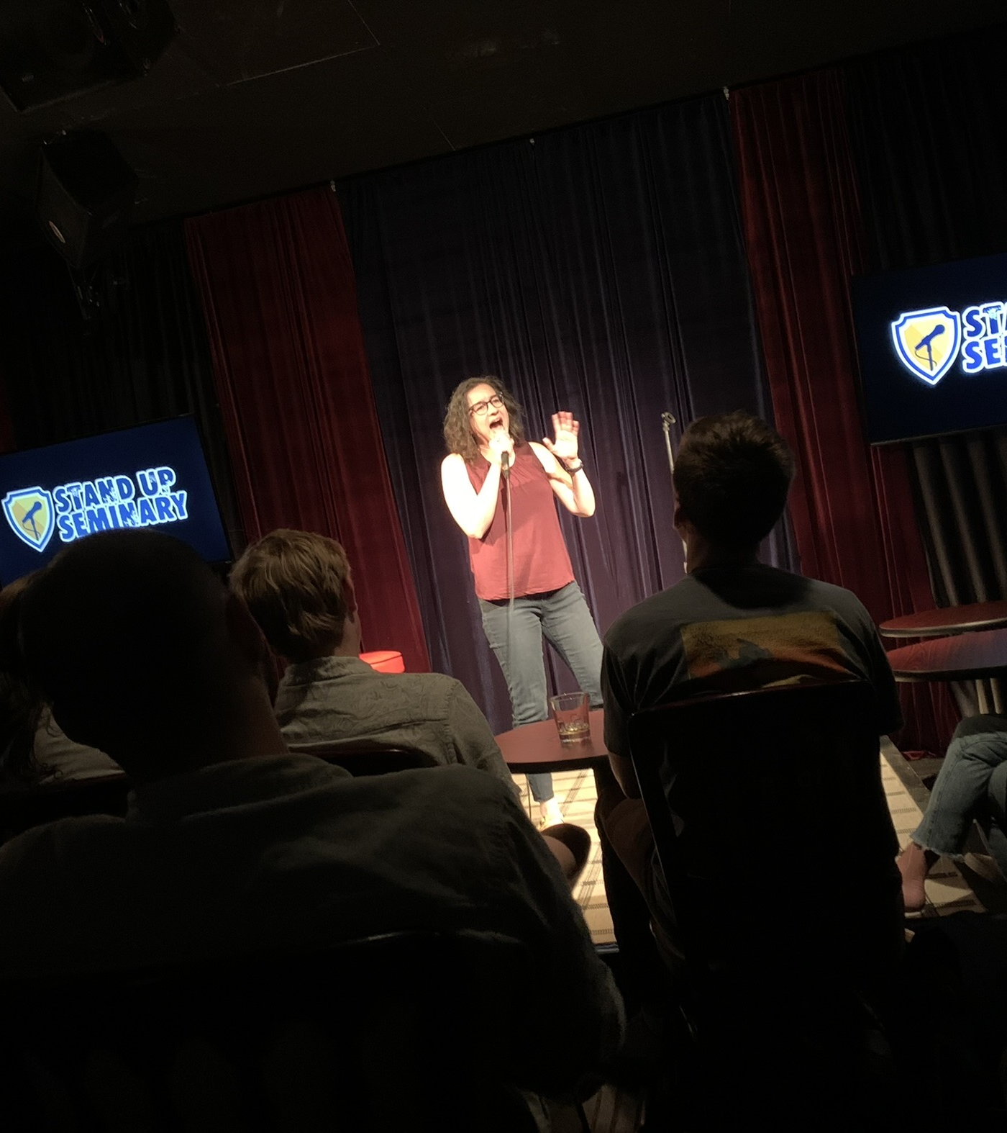
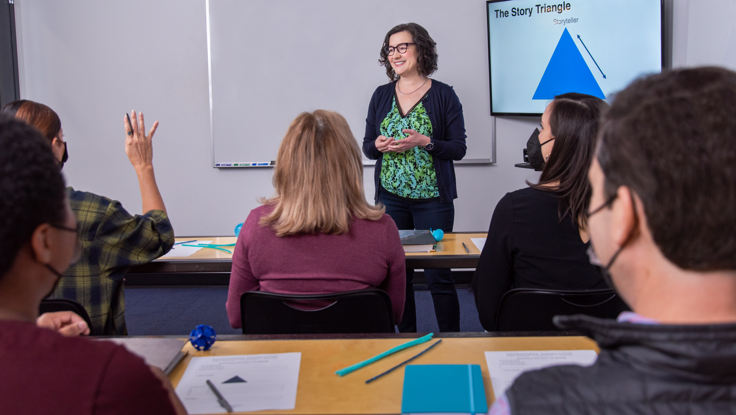
About Me…
Help people speak with
confidence + calm
Workshops + coaching
Improv + stand-up

Slide 5
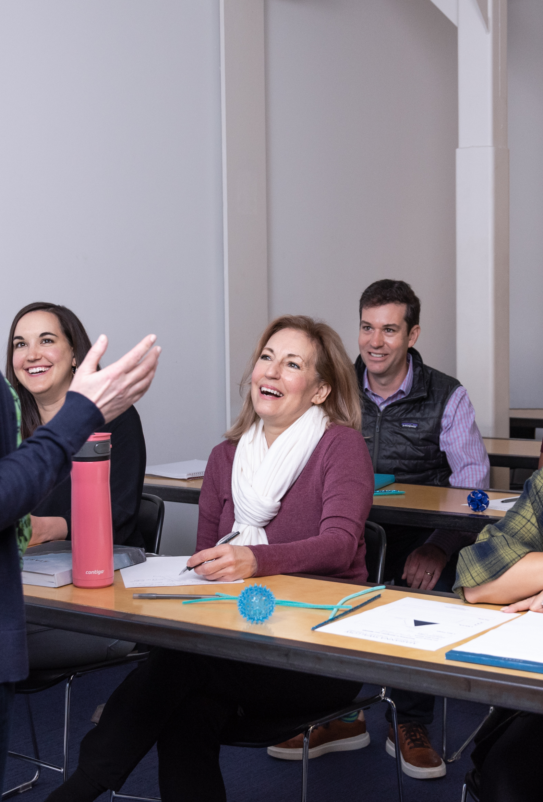
Goal:
Minimum 1 way to strengthen Presentations

Slide 6
Agenda
The secret question
Create connection
Avoid the credibility killers

Slide 7
1. Answer the secret question

Slide 8
The secret question…
WIIFM?
What’s In It
For Me?

Slide 9
SHARE THE “WIIFM?”
Promise
Benefit
Reflect their needs
Ask about their concerns

Slide 10
2. CREATE CONNECTION

Slide 11
Make connections with…
Correlations
Analogies
Language

Slide 12
Make connections with…
Correlations

Slide 13

Lady Gaga reminds me of Madonna!
Olivia Rodrigo sounds like Taylor Swift!

Slide 14
Make connections with…
Analogies

Slide 15
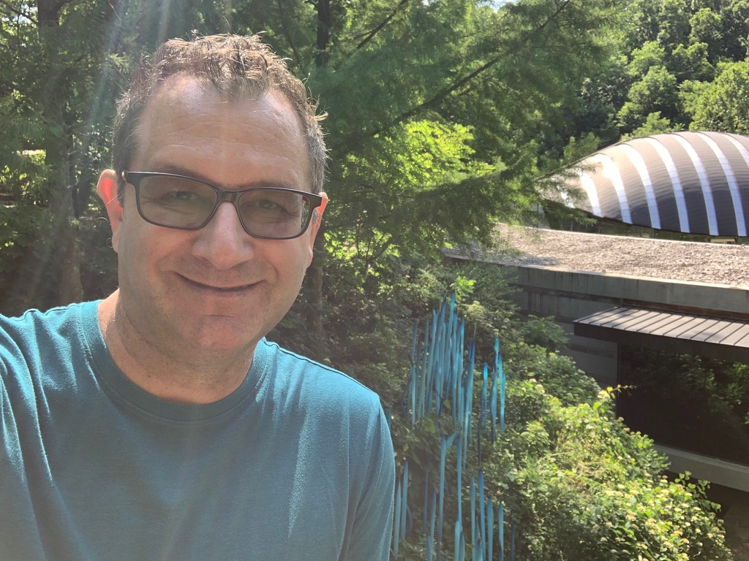
Meet Kevin, sr. product manager
I manage a tool that allows us to communicate across the company, globally; it’s like a Linked In or Facebook, but just for the company. It saves us from having to send a thousand emails.

Slide 16
Make connections with…
Language

Slide 17

…target demographic?
…conversion?
customer?
…competition?
…rebrand?
…Brand?
…your industry?

Slide 18
3. Avoid the credibility killers

Slide 19
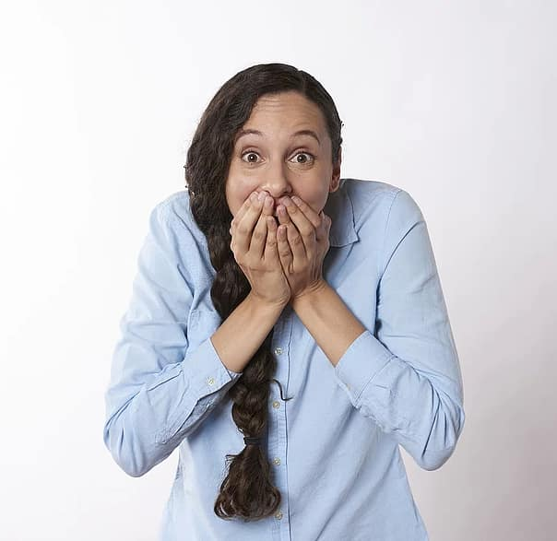
credibility killer =
Unconscious habits, words, or phrases that undermine a strong message.

Slide 20
LOOK OUT FOR…
Qualifiers
Apologies

Slide 21
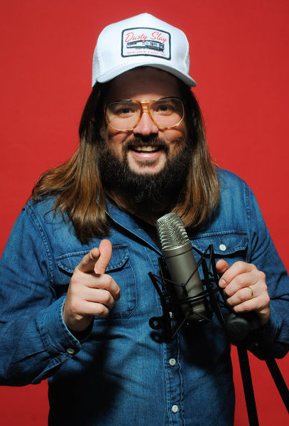
Lead with the positive!
“I like to tell people we’re having a good time. I don’t like to ask.”
Comedian Dusty Slay

Slide 22
RECAP
The secret question
  “What’s in it for me?”
Create connection
  Correlations, Analogies, Language
Avoid the credibility killers
  Apologies + Qualifiers

Slide 23
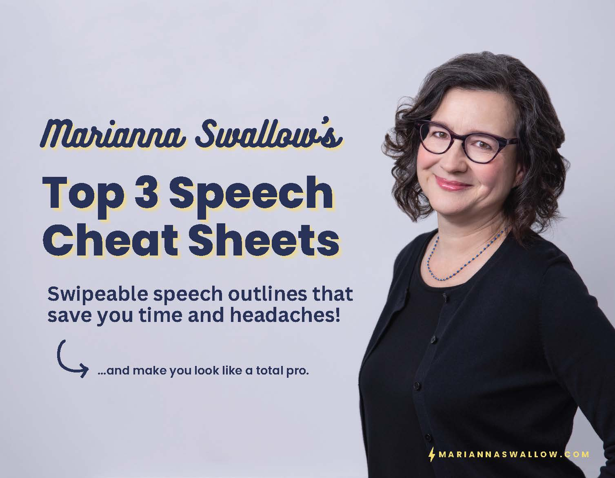
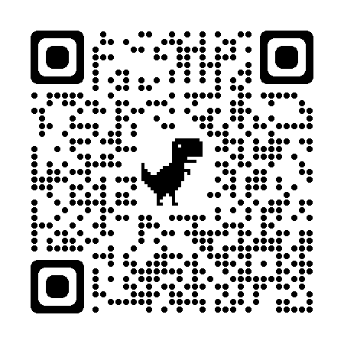
mscheatsheets.com

Slide 24
Last-Minute Speech
Motivated Sequence
Future Vision
mscheatsheets.com

Slide 25
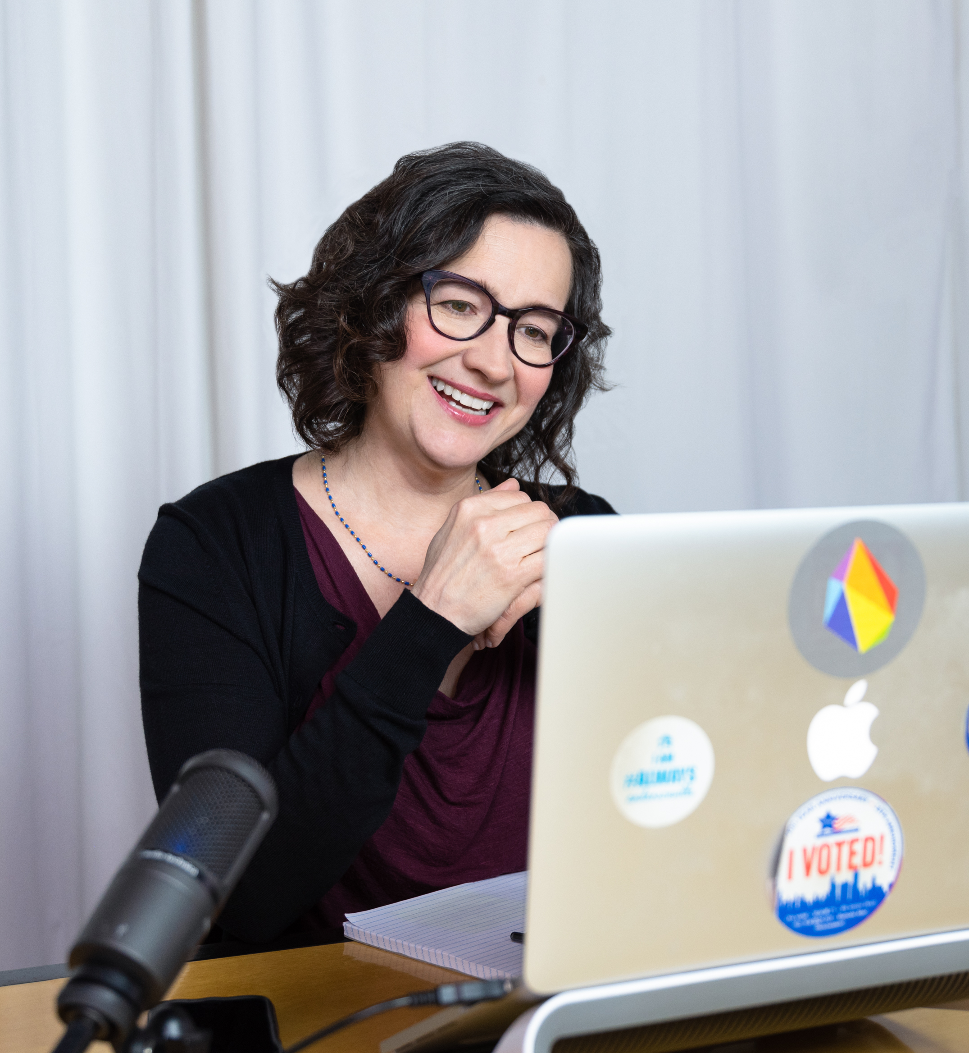
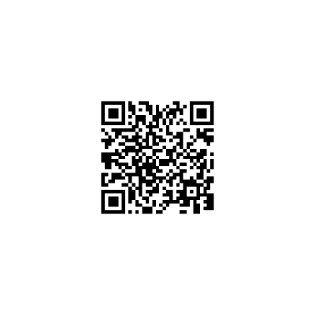
Free
Consultation:

Slide 26
What’s Your Commitment?
cheat sheets
free consultation

Slide 27




Slide 28
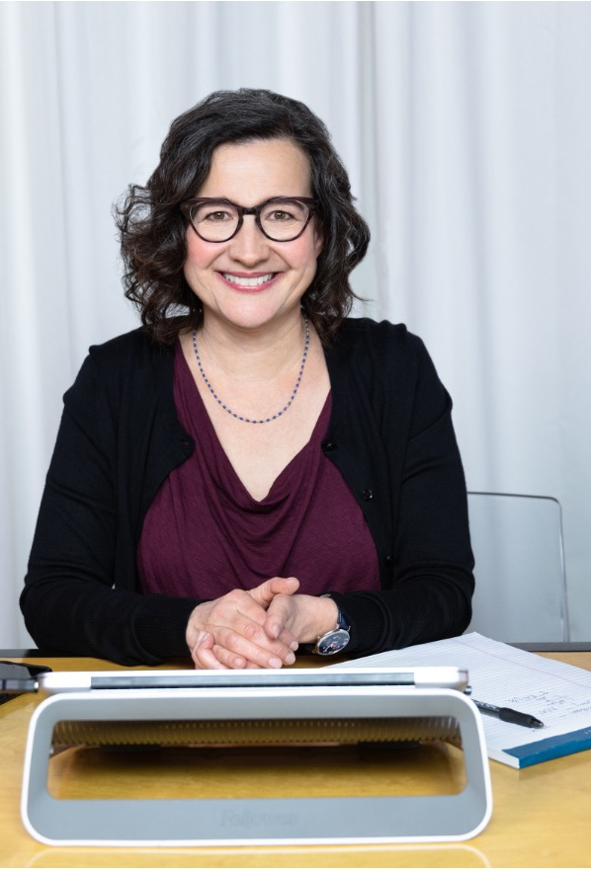
Thank you!
SPEAK WITH STRENGTH
Marianna Swallow mariannaswallow.com

Slide 29
Thank you!
SPEAK WITH STRENGTH for
TVB Virtual Forward Sales Conference 2024
Marianna Swallow
mariannaswallow.com

