Slide 1
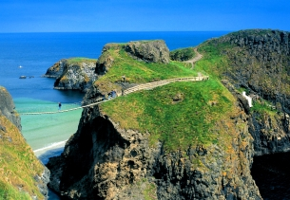
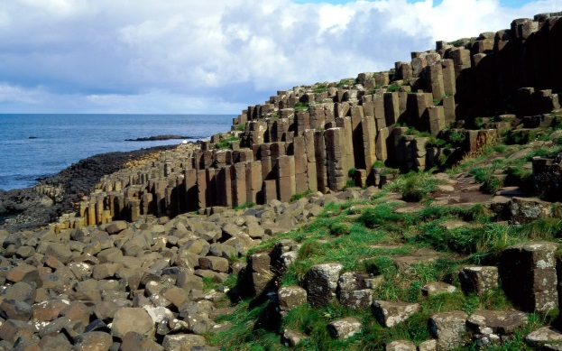
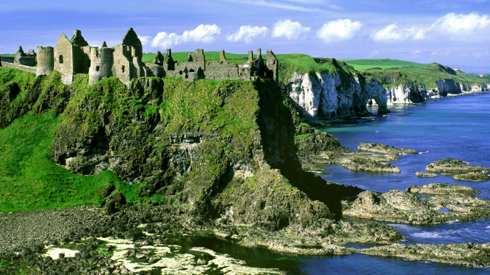
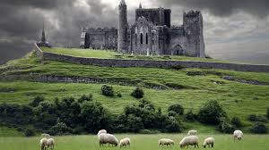
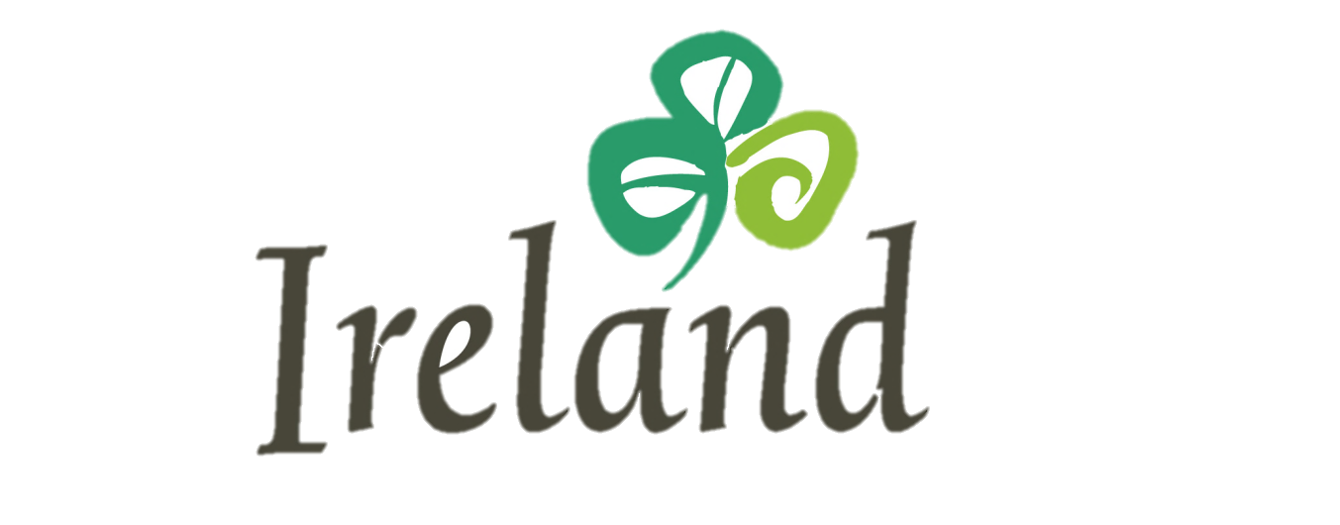
“Experience Ireland in 2015”
NBC Holiday Broadcast and Digital Recap

Slide 2
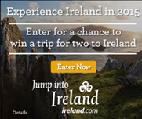
Campaign Summary
The NBC Stations partnered with Tourism Ireland and Carat to produce a multi-platform, multi-market campaign designed to promote travel to Ireland in 2015.
A five market Broadcast TV buy (NYC, CHI, PH, DC, and LA) and six Market Digital Buy (NYC, CHI, PH, DC, Bos and LA) ran December 22nd- December 31st , 2014, providing Tourism Ireland with a dominant presence it in its priority markets.
With over 13,596,000 broadcast and 4,088,000 impressions served digitally, the Experience Ireland in 2015 campaign was a rousing success.
The following slides recap the campaign…

Slide 3
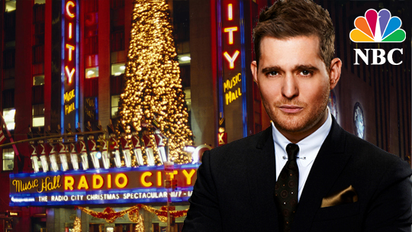
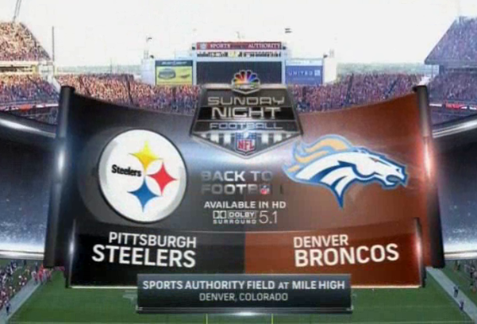
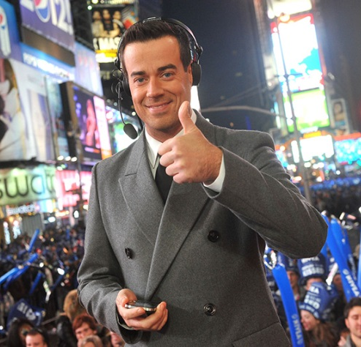
Broadcast campaign
NBC and Carat hand-picked a media schedule that combined premium programming and special events with a targeted day part mix.
Highlights included:
  Today Show
  Michael Buble’s Christmas Special
  Sunday Night Football (12/28/14
  New Year’s Eve with Carson Daly
  Broadcast campaign delivered 127% of estimated GRPS and 13.5MM impressions across the 5 markets

Slide 4
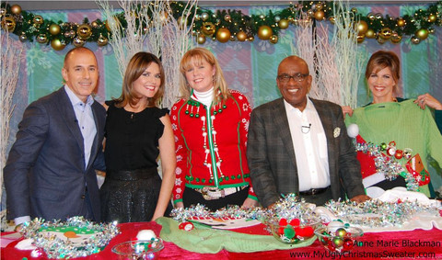
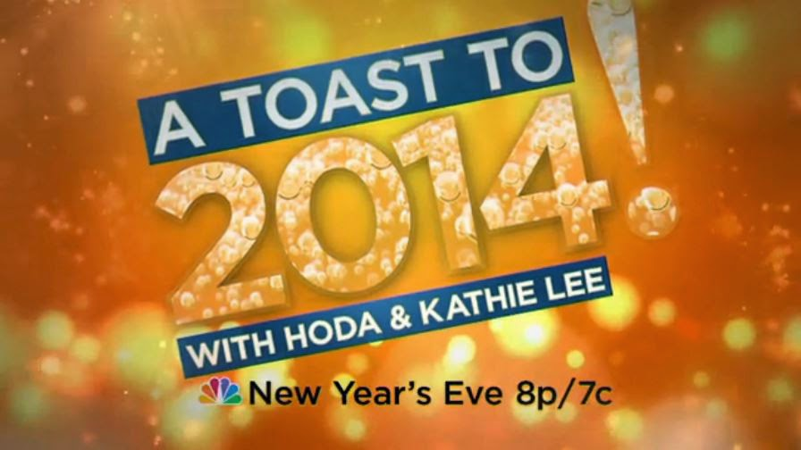
Broadcast delivery
** an attached excel plan provides detail by market and program

Slide 5
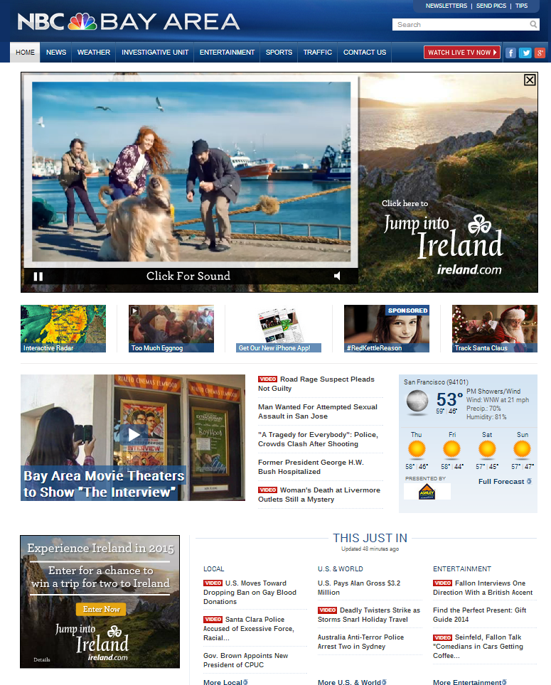
Digital Summary
12 Homepage Takeovers (2 per market)
1 Week of Native Advertising in each market
Experience Ireland Sweepstakes
Tourism of Ireland branded E-Blast
Desktop and Mobile Rotational Placements
Digital Campaign delivered 4,088,306 impressions, 92 % of the estimate* (see attached plan for details). Additional highlights include an aggregate CTR of .4%, 5 times higher that the industry standard, and 11,000 sweepstakes entries.
*As of 1.08.15, NBC has offered to run an additional 350,000 impressions as “make good”

Slide 6
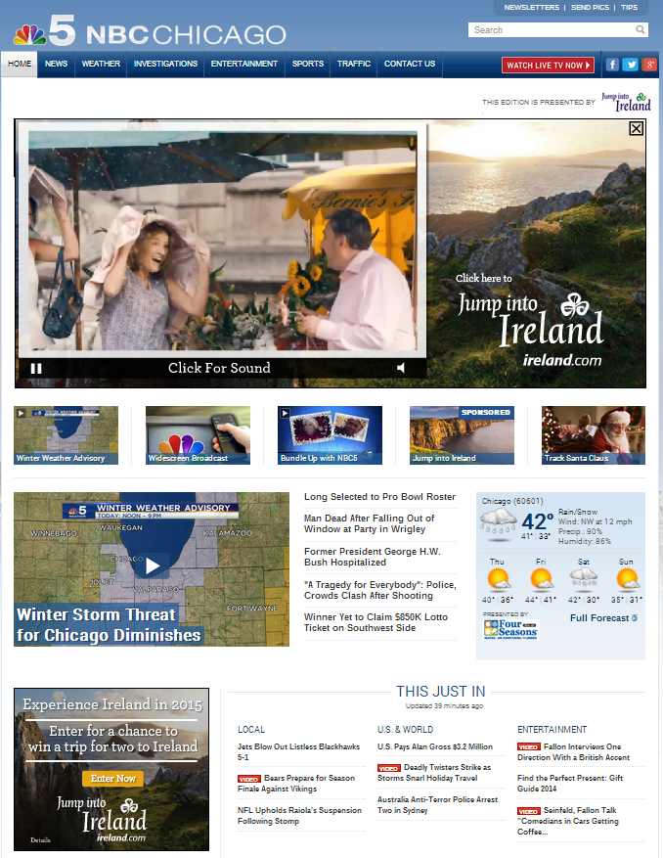
Homepage Takeovers
Tourism of Ireland was given 2 Homepage Takeovers per market. The takeovers were strategically placed on specific dates within flight
1.4MM Impressions Delivered
.22% CTR
IMAGE

Slide 7
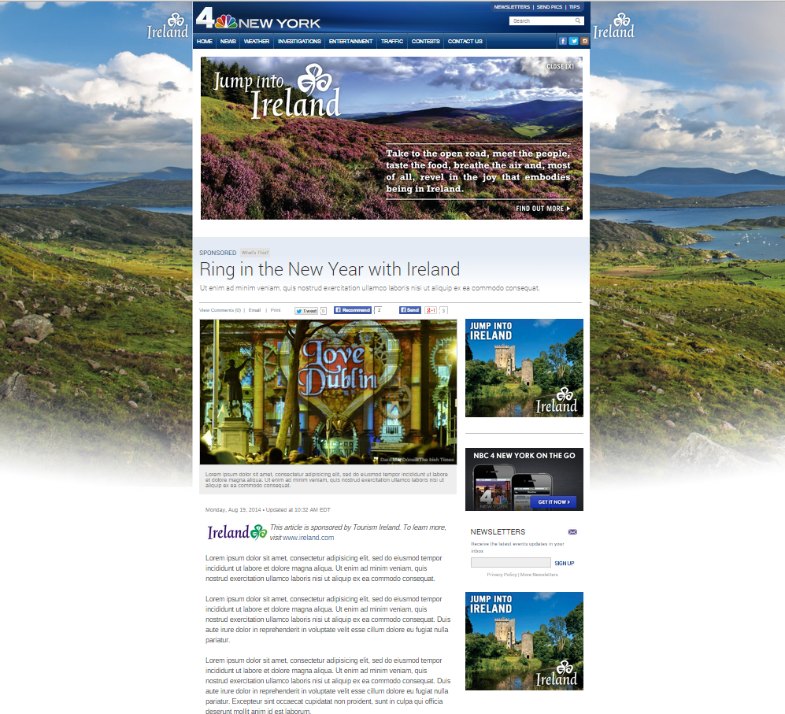
Native advertising
Native Advertising was content created by NBC in collaboration with Tourism of Ireland promoting why people should Ring in the New Year with Ireland. The was live the entire flight of the campaign.
863,000 impressions delivered
.09% CTR

Slide 8
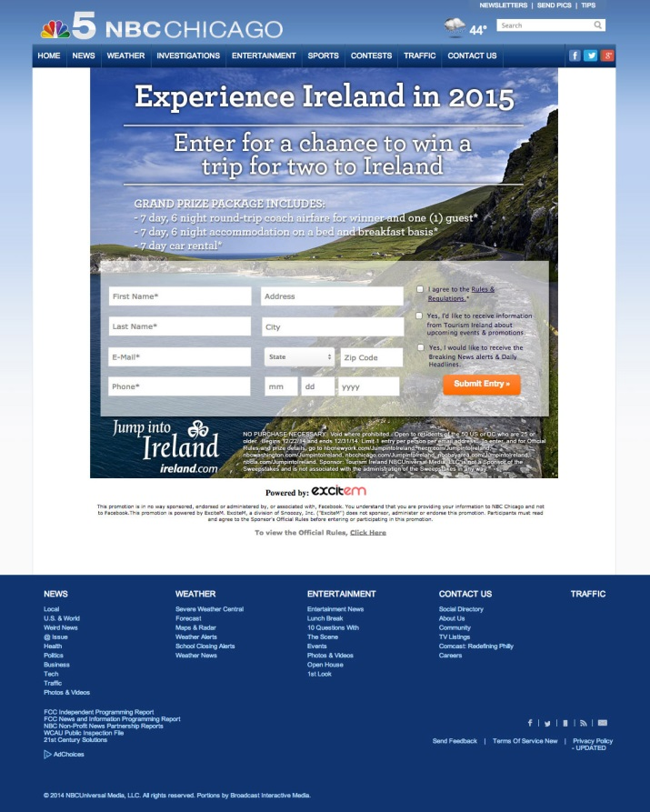
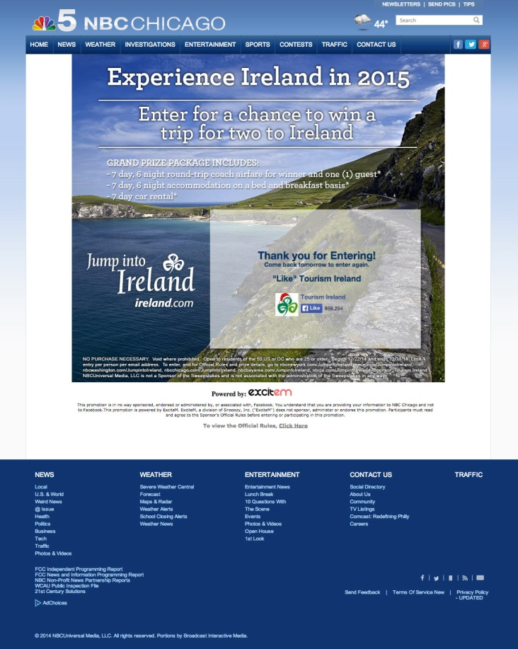
Experience Ireland in 2015 Sweepstakes
IMAGE
Over 11,000 Contest Entries collected. This is marketing collateral Tourism of Ireland can use for future initiatives

Slide 9
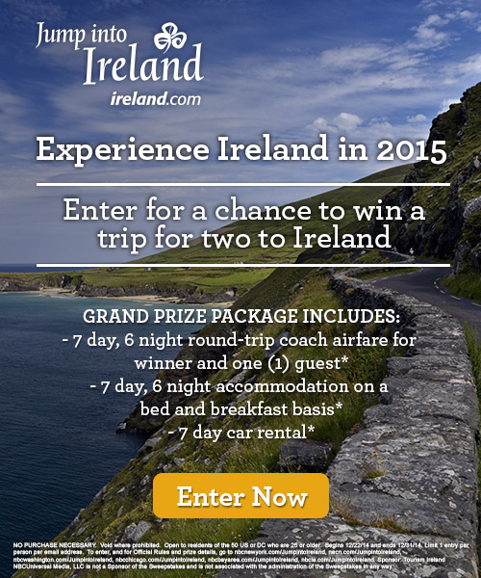
Experience Ireland 2015 e-blast
Tourism of Ireland was given the opportunity to send out branded e-blasts to promote the Experience Ireland Sweepstakes
158,000 recipients
22,718 Opens
14.42% Open Rate
19.6% CTR
IMAGE

