Slide 1
Hot Categories &
Successful Advertisers
April 23, 2020

Slide 2
Agenda
Interview hosted by Brian Wexler, SVP, Business Development, TVB
with Scott Fink, President, Fink Automotive Group
Interview hosted by Brian Allers, SVP, Business Development, TVB
with Dr. Jeremy Fry, President & CEO, Fry Orthodontics
National Advertising Roundtable:
hosted by Brad Seitter, EVP, Business Development, TVB
with Artie Altman, EVP, Katz TV Group
& with Ray Karczewski, EVP, Sales, CoxReps
Audience Q&A

Slide 3
Continue Advertising!!
“Cutting advertising doesn’t freeze the brand’s position in the market but rather begins an immediate substantial downward trend in demand.”
Source: Marketing Science Institute (MSI) 2020

Slide 4
Continue Advertising!!
“Business goes where it’s invited!”
- Louis Wall, President & CEO, SagamoreHill Broadcasting

Slide 5
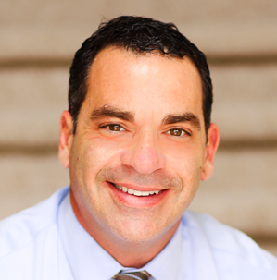
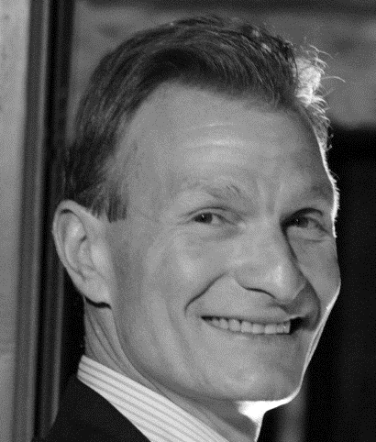
Interview
Brian Wexler
SVP, Business Development
TVB
Scott Fink
President
Fink Automotive Group

Slide 6
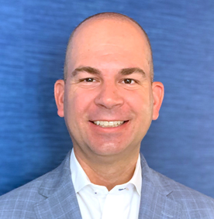
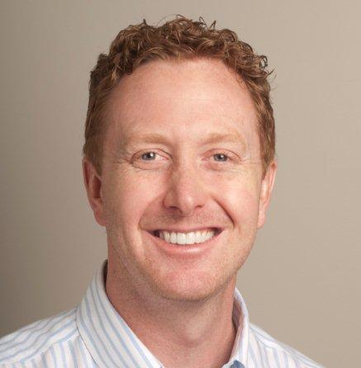
Interview
Brian Allers
SVP, Business Development
TVB
Dr. Jeremy Fry
President & CEO
Fry Orthodontics

Slide 7
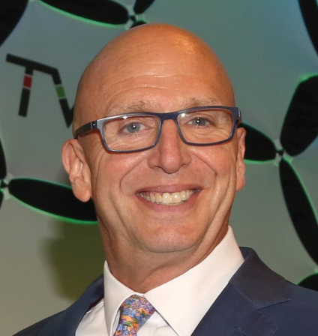
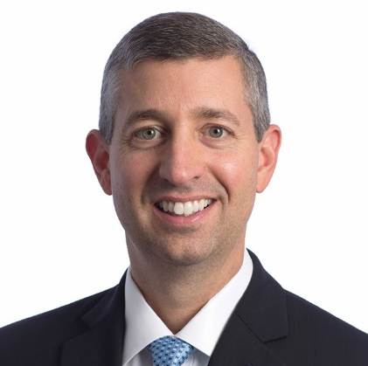

National Advertiser Roundtable
Artie Altman
EVP
Katz TV Group
Moderator:
Brad Seitter
EVP, Business Development
TVB
Ray Karczewski
EVP, Sales
CoxReps

Slide 8
States Easing COVID-19 Restrictions
Georgia
  Monday, April 27: Restaurants can reopen
  Thursday, April 30: Gyms, Bowling Alleys, Movie Theaters and Salons can reopen
Tennessee
  Governor announced he will not extend stay at home order past April 30
  All businesses will be permitted to reopen though there may be exceptions in larger cities
South Carolina
  Retail stores may immediately reopen but will be required to abide by social distancing rules
  Gyms, Bowling Alleys, Movie Theaters and Salons will remain closed
Pennsylvania
  Auto dealers are now allowed to sell online
Alaska
  Restaurants and retail stores reopening Friday, April 24

Slide 9
Additional States Expected to Ease COVID-19 Restrictions in May
Alabama
Arizona
Arkansas
Colorado
Florida
Idaho
Indiana
Iowa
Kansas
Minnesota
Mississippi
Missouri – May 4
Montana
North Dakota
Ohio
Oklahoma – May 1
Texas
Utah
Vermont
Wyoming

Slide 10
National Advertiser Roundtable
Artie Altman
EVP
Katz TV Group
Moderator:
Brad Seitter
EVP, Business Development
TVB
Ray Karczewski
EVP, Sales
CoxReps

Slide 11
Audience Q&A

Slide 12
TVB Town Hall: Focus on Mortgage Advertising
Wed., April 29th at 1pm (ET)
Ann Hailer (COO, CoxReps) will conduct a 10-minute one-on-one interview with
Casey Hurbis (CMO, Quicken Loans) followed by an open Q&A.
If you would like to send your question in advance, please email Brad directly at brad@tvb.org.
Registration is available on the TVB Member Homepage.

Slide 13
Thank you!

